Slide 1




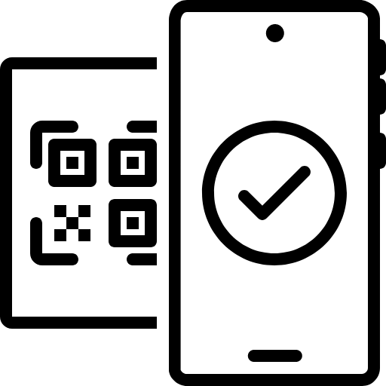
Paisa
Personal Budget Tracker
Presented By Group 6

Slide 2




Meet The Group
SUBHASH
PRANAV
ALOK
JYOTISH
102203609
102203627
102203580
102203632

Slide 3


Introduction
In today’s economy, Financial Management is an important skill to have. Especially for Students!
Our main goal is to make it as easy and seamless as possible.
The application is constructed with Oracle's PL/SQL, utilizing advanced relational database management techniques including stored procedures, functions, triggers, and cursors to improve data integrity and automate essential tasks.

Slide 4



Features
1
3
2
Reporting & Insights
User Management
Expense Tracking
offers reporting tools that generate real-time insights into budget utilization and financial health
managing user profiles, including registration, login, and user data maintenance.
the ability to record and categorize expenses against specific budgets.

Slide 5
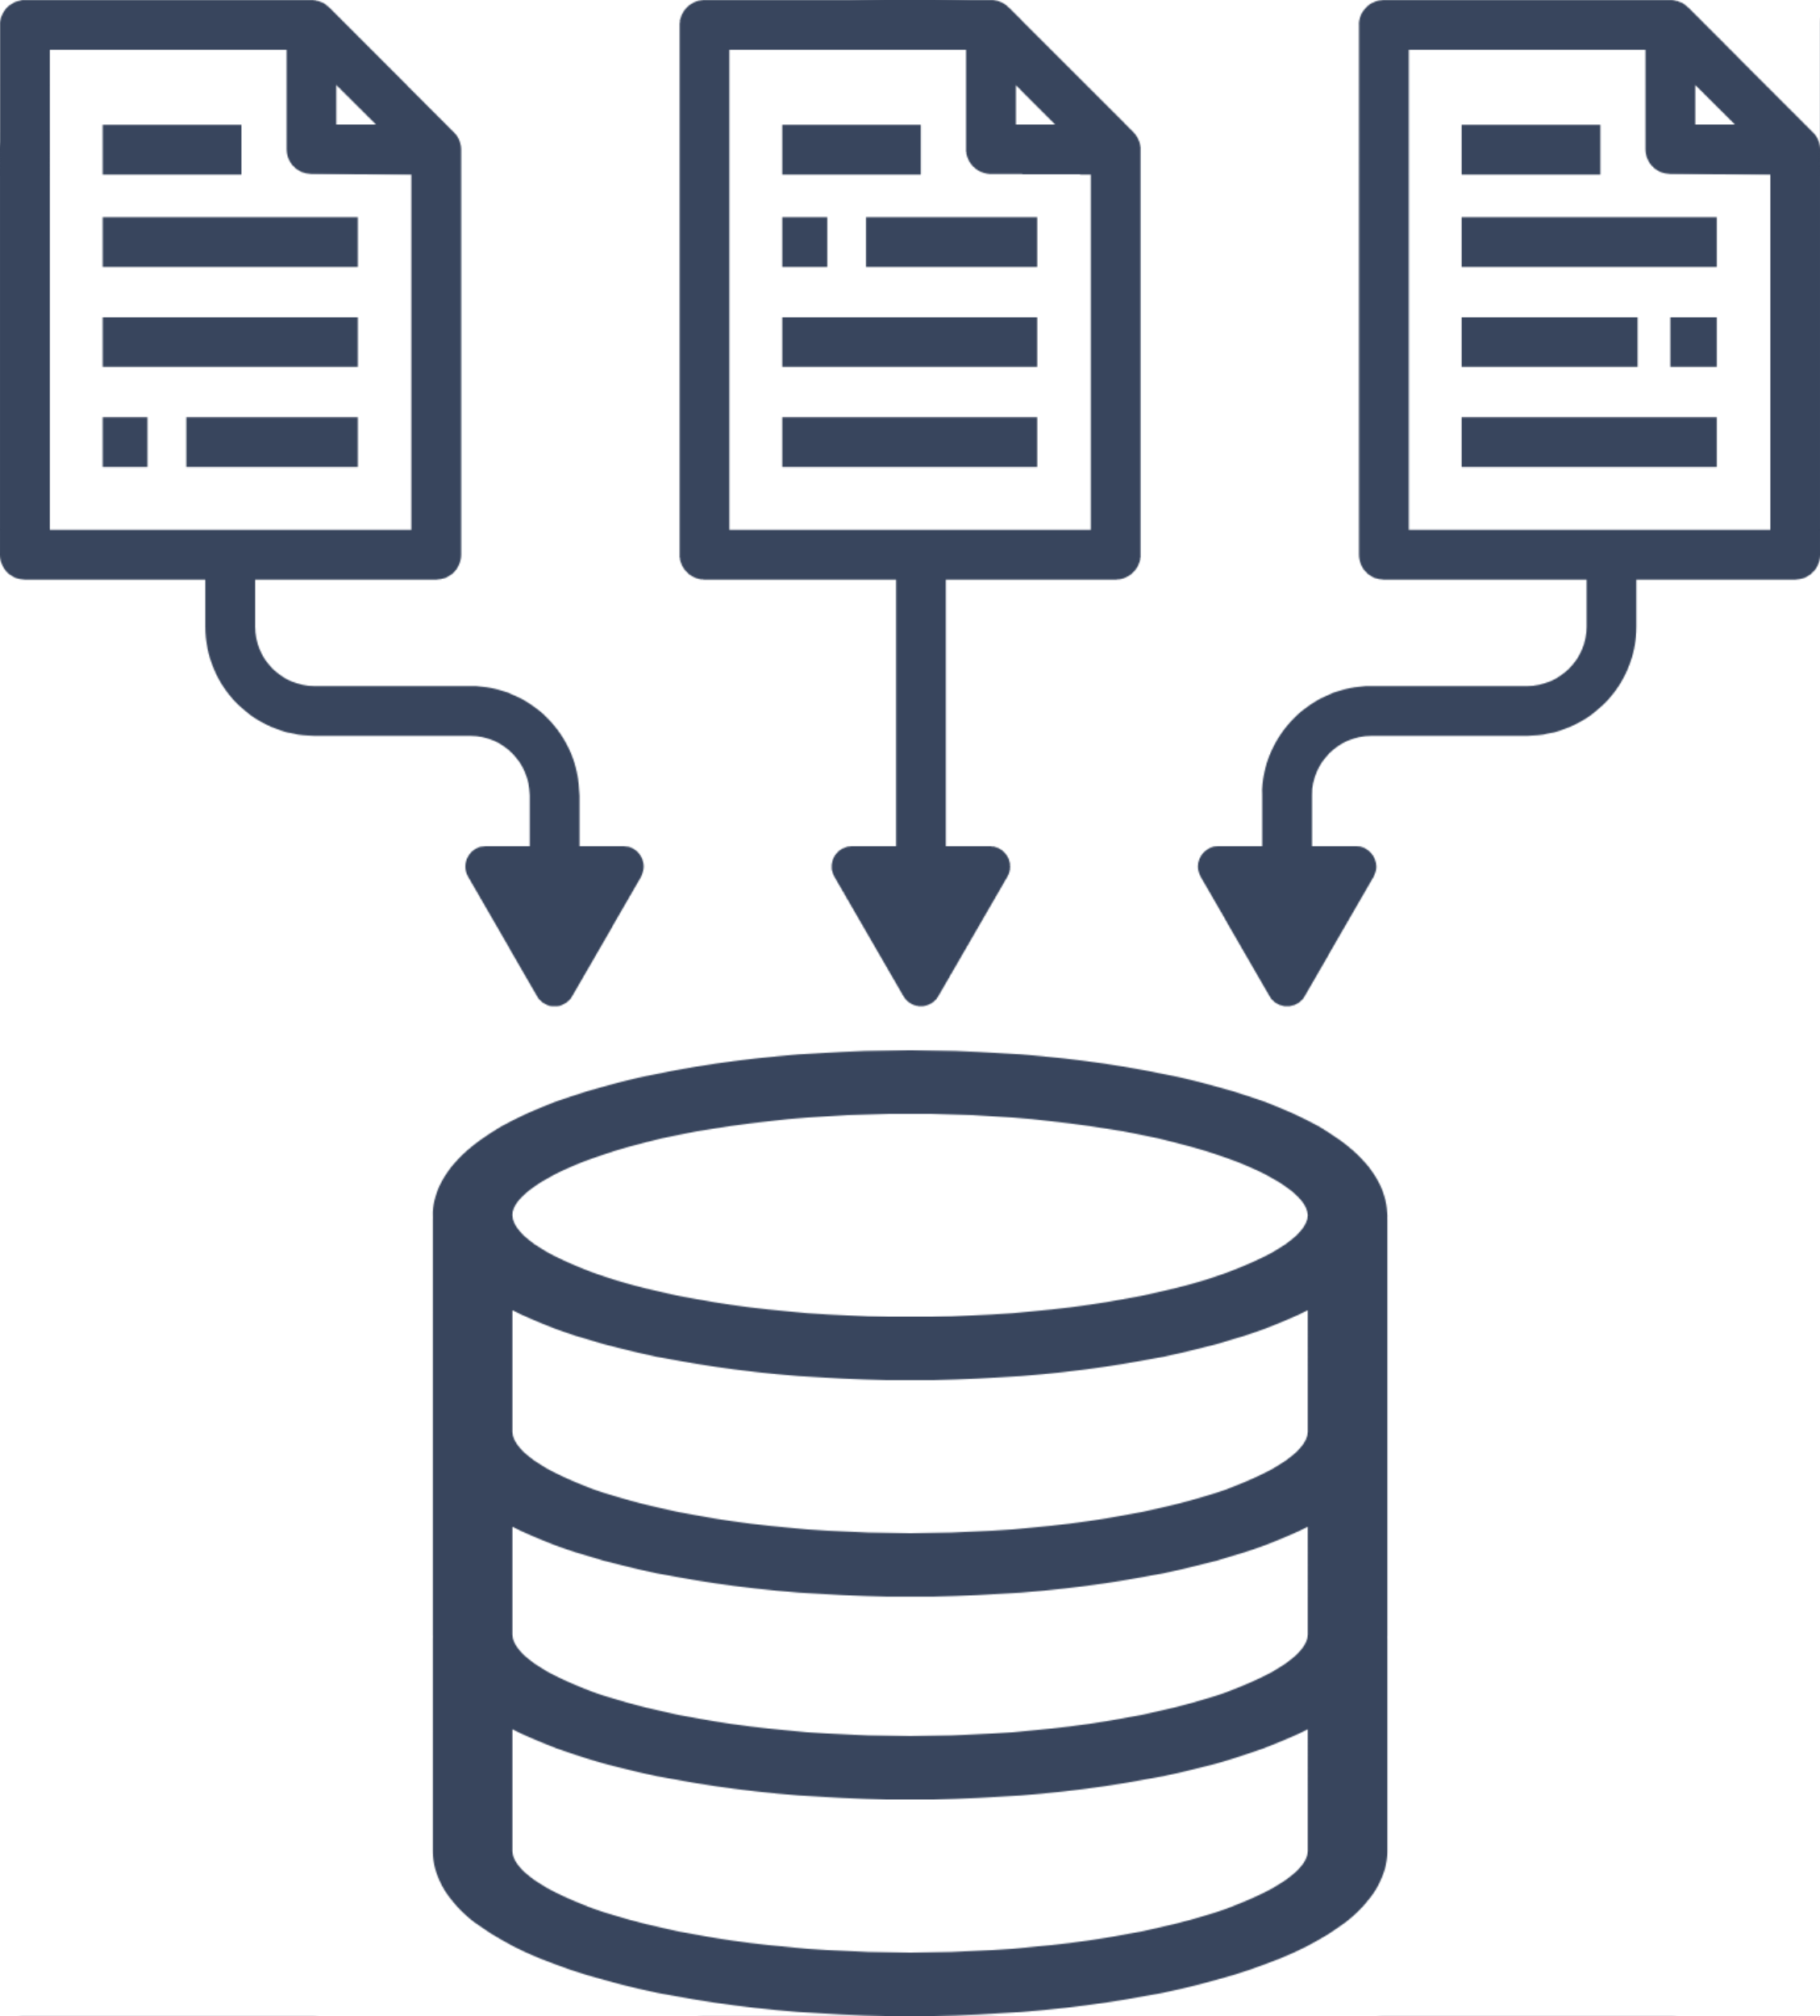

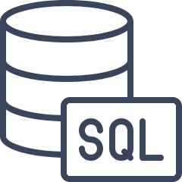
Features
4
6
5
Cursors &
Triggers
Data Security
SQL and PL/SQL
The system utilizes PL/SQL cursors and triggers for efficiently managing data retrieval operations
architecture of the system is designed with a focus on security and data integrity.
To compute complex queries and transactions, the system uses PL/SQL procedures and functions

Slide 6
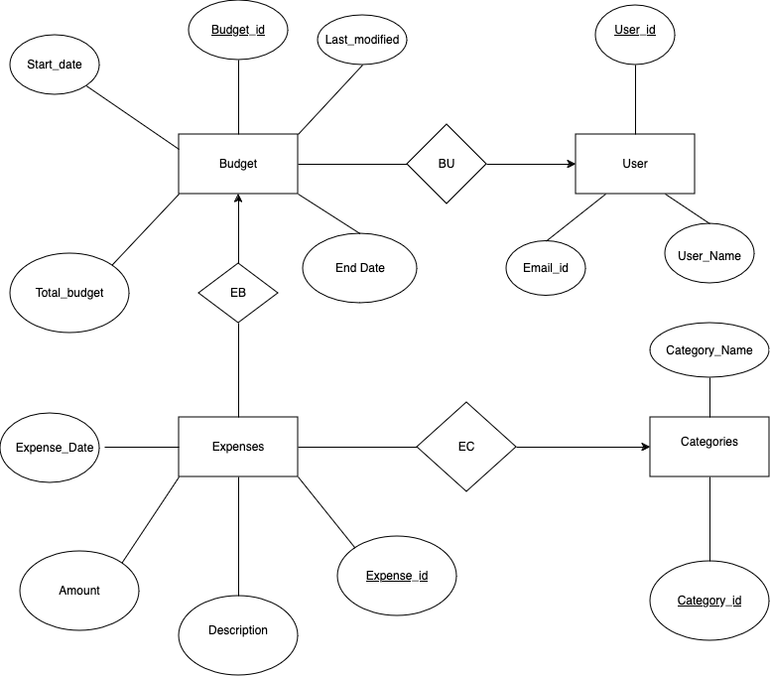
ER
Diagram

Slide 7
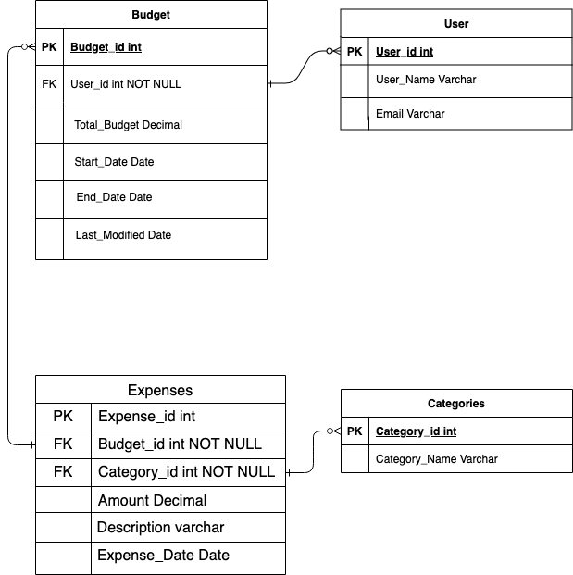
ER to
Tables

Slide 8
Normalization
Entities | Functional Dependencies | Normal Form
Users | user_id, username, email | 3NF
Budgets | budget_id, user_id, total_budget, start_date, end_date, last_modified | 3NF
Expenses | expense_id, budget_id, category_id, amount, description, date_incurred | 3NF
Categories | category_id, category_name | 3NF

Slide 9
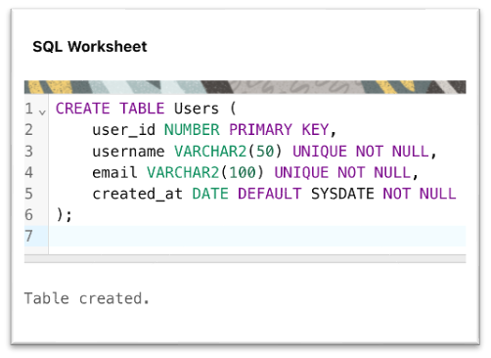
SQL
Creating Tables

Slide 10
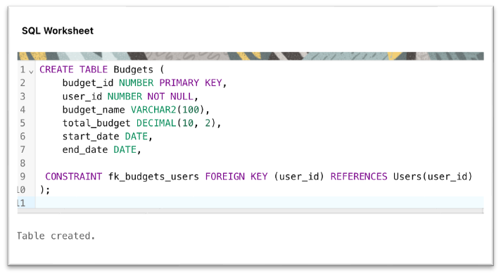
SQL

Slide 11
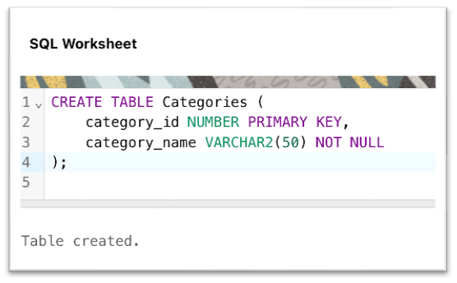
SQL

Slide 12
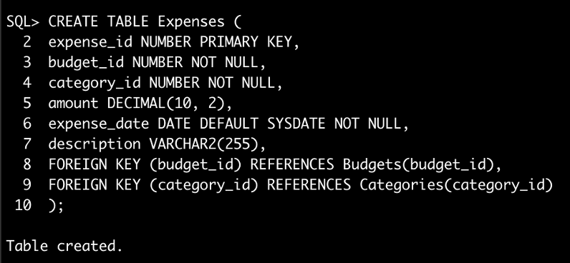
SQL

Slide 13
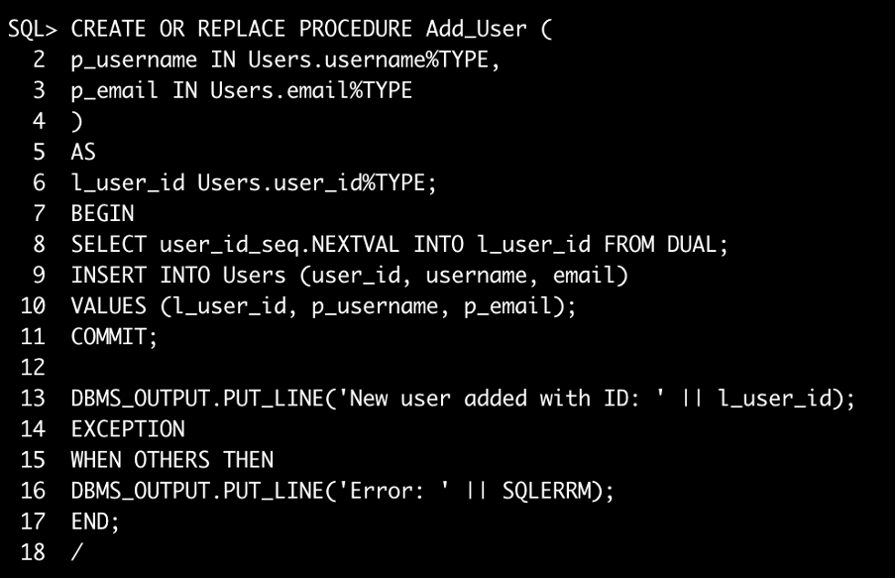
PL/SQL
Stored Procedures and Cursors

Slide 14
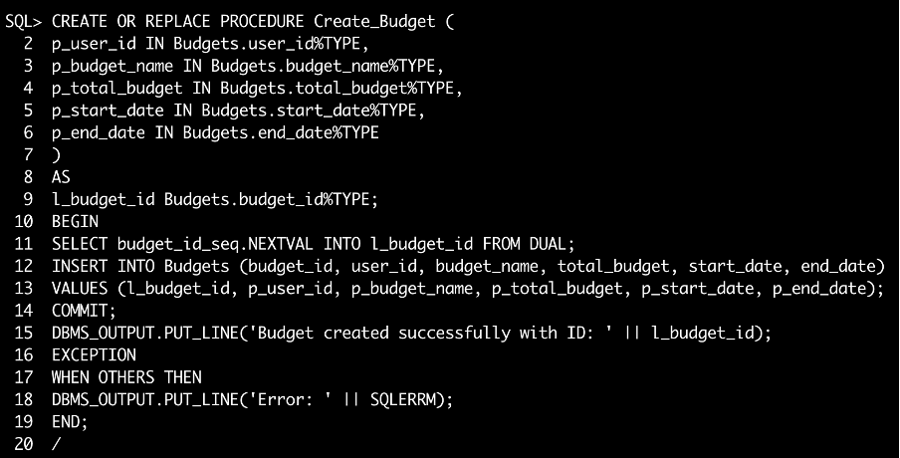
PL/SQL

Slide 15
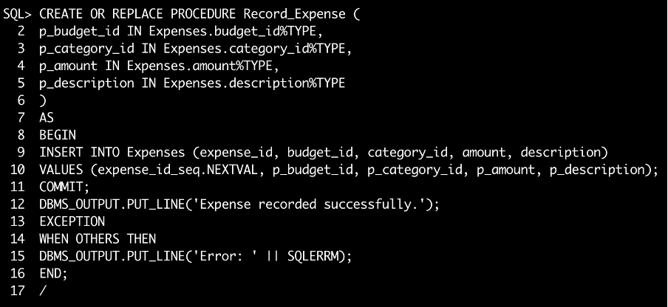
PL/SQL

Slide 16
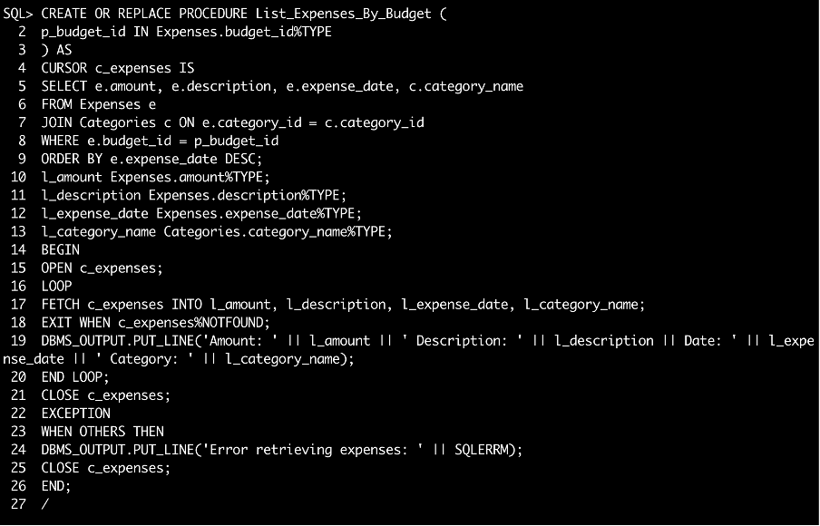
PL/SQL

Slide 17
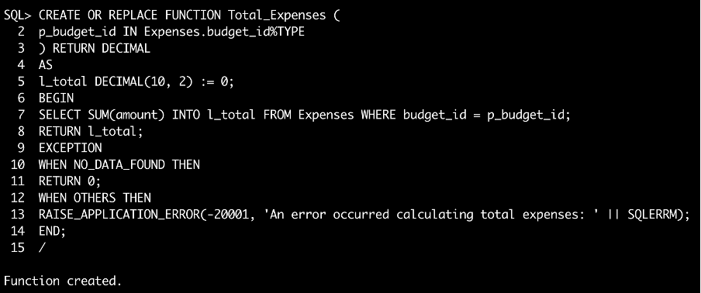
PL/SQL
Stored Functions and Triggers

Slide 18
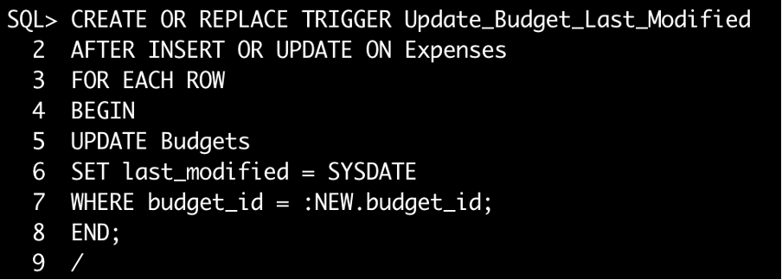
PL/SQL

Slide 19
Conclusion

Slide 20
Thank you!

Slide 22

ANY QUESTIONS?

